Slide 1
Introduction to HTML
COMP 2511 - Web I: Client Development
Yasaman Amannejad,
Added to by Jim Davis
Department of Mathematics and Computing,
Mount Royal University

Slide 2
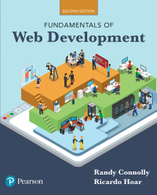
Objectives
By the end of this part of the course, you will
learn what HTML is used for
understand the basic structure of a HTML page
learn basic HTML tags
Textbook: Fundamentals of Web Development
Chapters 3

Slide 3
Brief History of HTML
The word internet means a collection of networks that are joined together. Thus, the word Internet, with a capital 'I', means 'The planet-wide collection of networks that are linked together.’
Pentagon's Advanced Research Projects Agency (ARPA) wanted to install a network in the USA. The network consisted of four high speed computers, and was known as ARPANET.

Slide 4
Brief History of HTML
In 1990 there was no easy way to find, download and view documents.
Tim Berners Lee invented a system that would:
store documents in one central place (i.e., a web server)
make it possible to view and download a document with a single click (i.e. a web browser)
Allow people to find other documents by clicking on links inside documents.

Slide 5
Brief History of HTML
World-Wide-Web is a collection of hyperlinked pages of information distributed over the internet.
This was invented by Tim Berners-Lee, a physicist working at CERN.
He wanted a way for physicists to share information about their research - the World-Wide-Web was his solution.
Initially, the Web was text-only. The early browser was Links.
Graphics came later with a browser called NCSA Mosaic.
Both Microsoft's Internet Explorer and Netscape were originally based on NCSA Mosaic

Slide 6
Brief History of HTML
1991
HTML first published – Tim Berners-Lee
1994
W3C is formed
W3C, the main standards organization for the World Wide Web, was formed by Time Burners-Lee
1995
HTML 2.0
1997
HTML 3.2
After this, the focus shifted to XHTML and its stricter standards
1999
HTML 4.01
2000
XHTML 1.0
XHTML 2.0 had even stricter standards than 1.0, rejecting Web pages that did not comply
2002
XHTML 2.0
2009
2012
HTML5
It has been in development since 2004. More tolerant and has a backward compatibility.

Slide 7
HTML5
The main aims of HTML5 are:
Imptove the language suppory for multimedia.
Provide an open, non-proprietary programming framework (via Javascript) for creating rich web applications.
Be backwards compatible with the existing web.
To specify, unambiguously, how browsers should deal with invalid markup.

Slide 8
What is HTML used for?

Slide 9
What is HTML used for?
Adding content to your Website
Examples for the content types:
Text, Video, Lists
Links, Audio, Forms
Images, Tables, Structure
Content should be created using HTML
Presentation and layouts should be implemented by CSS

Slide 10
Markup
markup is a way to indicate information about the content
This “information about content” in HTML is implemented via tags (aka elements).
Word Perfect used it to render Bold and other effects.
HTML does the same thing, it also uses textual tags.

Slide 11
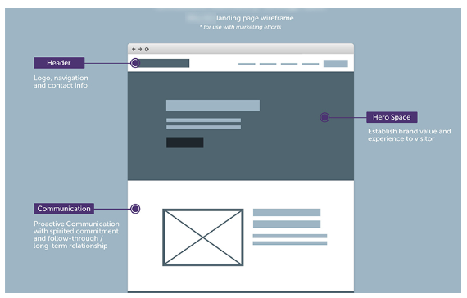
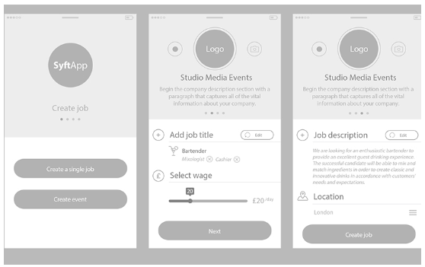
Possible roles in the Web market
Graphic designer
can design widgets, icons, graphics to be used in a Web page.
Web/UI designer
They analyze the requirements of a web application and based on that create mock ups that will suitably accomplish the task. They create “high fidelity diagrams” that would require specialised software like photoshop to design the page look and in the process take care of typography, color combination and a bunch of other stuff.
Low fidelity diagram
High fidelity diagram

Slide 12
Possible roles in the Web market
Front-end developer
Starts where web designing ends. They take those high fidelity diagrams and then code it in html, and css to look exactly like the diagram and apply javascrip to create behaviour. The final output of this process are html documents which when run in a browser look and work exactly like they were designed.
Back-end developer
They take finished front-end codes and give them working functionality—for instance, making values in a drop-down menu possible by building the infrastructure that pulls values from the database.
Full stack developer
who is able to work on both the front-end and back-end portions of an application.
Webmaster/administrator
Webmasters are computer specialists who maintain websites. Webmasters are also called web administrators.

Slide 13
Structure of HTML

Slide 14
HTML
HTML (Hypertext Markup Language)
Is not a programming language.
It describes the content and structure of a web page.
It is made up of building blocks called elements.
Elements can have attributes.
<p>
HTML is <em> awesome! </em>
<img src="puppy.png" />
</p>

Slide 15
Creating HTML File
We’ll create HTML documents by typing HTML markup text in a text editor (such as Notepad++, bracket, Visual Studio Code or BBEdit or TextEdit) and saving it with the .html or .htm filename extension.
Computers called web servers store HTML documents.
Clients (such as web browsers running on your local computer or smartphone) request specific resources such as HTML documents from web servers.

Slide 16
Simplest HTML Document
Title Element
The title element describes the web page.
Titles usually appear in the title bar at the top of the browser window, in the browser tab on which the page is displayed, and also as the text identifying a page when users add the page to their list of Favorites or Bookmarks, enabling them to return to their favorite sites.
Search engines use the title for indexing purposes and when displaying results

Slide 17
A More Complete Document

Slide 18
DOCTYPE
(short for Document Type Definition)
Tells the browser (or any other client software that is reading this HTML document) what type of document it is about to process.
DOCTYPE is required in HTML5 documents so that browsers render the page according to HTML standards.

Slide 19
html
The <html> element is sometimes called the root element as it contains all the other HTML elements in the document.

Slide 20
Head and Body
The head contains descriptive elements about the document.
The body contains content that will be displayed by the browser.

Slide 21
Inside the Head
No brains but metas, styles and javascripts
The first of these is the <meta> element. Our example declares that the character encoding for the document is UTF-8.
Our example specifies an external CSS style sheet file that is used with this document.
It also references any external Javascript file.

Slide 22
HTML Syntax

Slide 23
Elements
HTML documents are composed of textual content and HTML elements.
An HTML element can contain text, other elements, or be empty. It is identified in the HTML document by tags.
HTML documents delimit most elements with a start tag and end tag.
A start tag consists of the element name in angle brackets: For example, <html>
An end tag consists of the element name preceded by a forward slash (/) in angle brackets: For example, </html>
There are several so-called “void elements” that do not have end tags.
In HTML5 we do not ‘create’ end tags for elements that do not have them.

Slide 24
Attributes
Many start tags have attributes that provide additional information about an element, which browsers use to determine how to process the element.
HTML elements can also contain attributes. An HTML attribute is a name=value pair that provides more information about the HTML element.
Although not required in HTML, enclosing attribute values in either single or double quotes is strongly recommended.
Reminder:
Although, HTML elements and attributes are case insensitive, it is a good practice to use only lowercase letters.

Slide 25
Elements and Attributes
Note: Elements with no closing tags do not use a trailing slash in HTML5!

Slide 26
Nesting HTML Elements
Often an HTML element will contain other HTML elements.
In such a case, the container element is said to be a parent of the contained, or child, element.
Any elements contained within the child are said to be descendants of the parent element; likewise, any given child element, may have a variety of ancestors.
These elements are identified by indenting the child elements.

Slide 27
Hierarchy of Elements

Slide 28
Nesting HTML Elements
Close tags in reverse order of their use!

Slide 29
Nesting HTML Elements
In order to properly construct a hierarchy of elements, your browser expects each HTML nested element to be properly nested.
That is, a child’s ending tag must be listed before its parent’s ending tag.

Slide 30
Indentation for Nesting Elements
Indenting nesting elements emphasizes document’s structure and promotes readability. It is recommended to use three spaces for each level of indentation. (Whether you use 2, 3, 4, spaces or a tab for nesting, be consistent!)
<!DOCTYPE html>
<html>
<head>
<title> Test Page </title>
</head>
<body>
<div>
<p> Some Text </p>
<p> Some Text </p>
</div>
</body>
<html>
Indentation

Slide 31
W3C HTML5 Validation Service
HTML5 documents that are syntactically correct are guaranteed to render properly
HTML5 documents that contain syntax errors may not display properly
Validation services (e.g., validator.w3.org/#validate-by-upload) ensure that an HTML5 document is syntactically correct (Create a bookmark for this service in your browser.)
Most browsers attempt to render HTML documents event if they are invalid. This can lead to unexpected and undesirable results.
It is a good practice to always use the validation service!

Slide 32
Quick Tour of HTML

Slide 33
Comments
Insert comments in your HTML5 markup to improve readability and describe the content of a document.
The browser ignores comments when your document is rendered.
Comments start with <!-- and end with -->.

Slide 34
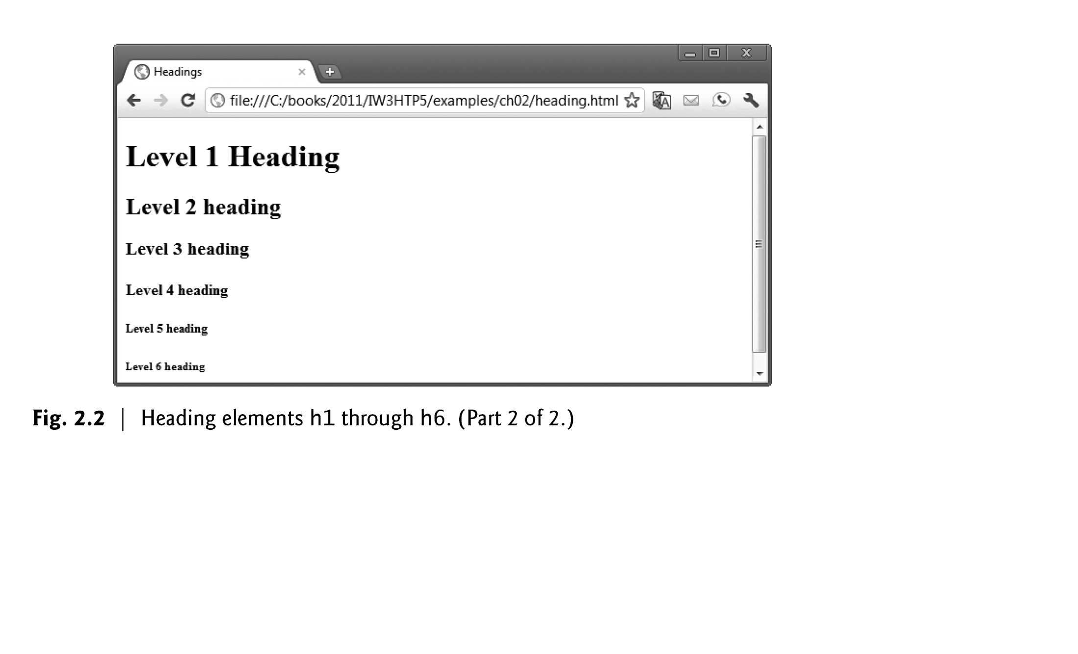
Headings
<h1> </h1>
<h2> </h2>
<h3> </h3>
.
.
.
<h6> </h6>

Slide 35
Paragraph
<p> </p>
Paragraphs are the most basic unit of text in an HTML document.

Slide 36
Subscript and Superscript
<p>On 17<sup>th</sup> January you will learn about E=MC<sup>2</sup>.</p> <p>The amount of C0<sub>2</sub> in the atmosphere is a lot.</p>
On 17th January you will learn about E=MC². The amount of C0₂ in the atmosphere is a lot.

Slide 37
Whitespace
<p>I am loving the warm sunshine
in Calgary today.</p>
I am loving the warm sunshine in
Calgary today.
Whitespace is collapsed!

Slide 38
Line Breaks
<p>I am <br> loving the warm
sunshine <br> in Calgary
today.</p>
I am
loving the warm sunshine
in Calgary today.
This is how we force white space.

Slide 39
Horizontal Rules
<p>I am loving the warm
sunshine in Calgary today.</p>
<hr>
<p>I am loving the warm
sunshine in Calgary today.</p>
I am loving the warm sunshine in
Calgary today.
I am loving the warm sunshine in
Calgary today.
Creates more formal separation than space alone.

Slide 40
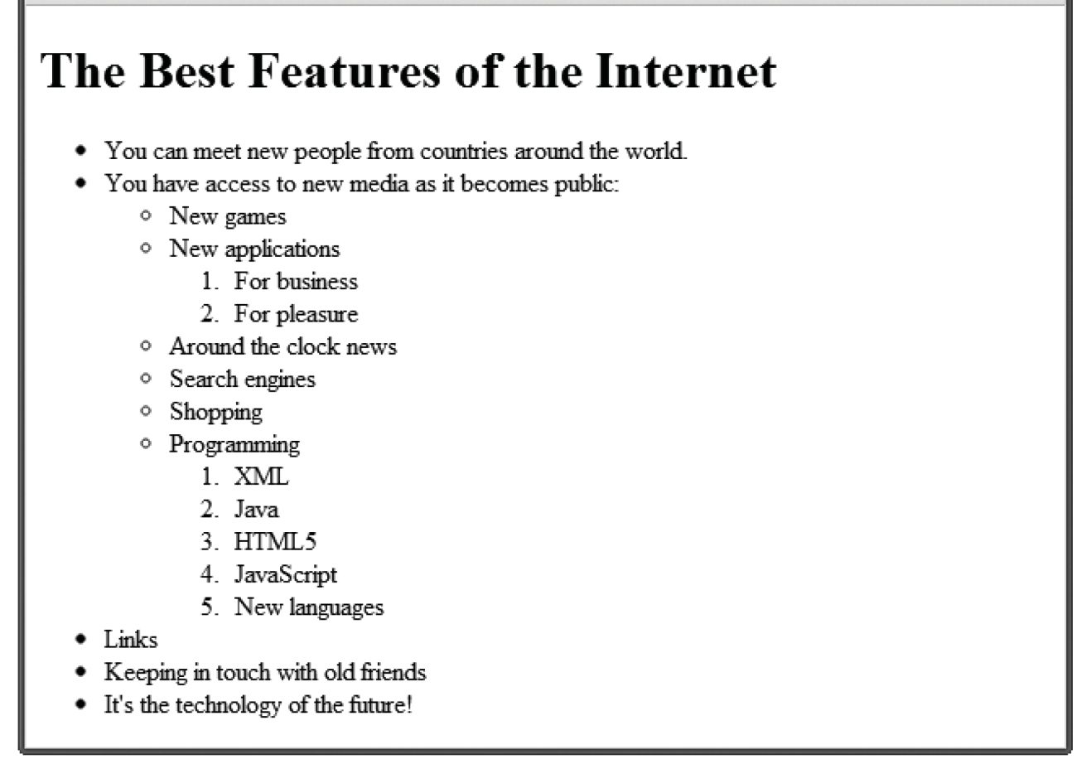



List Types
ORDERED
UNORDERED
DEFINITION
1. Chop potatoes into quarters 2. Simmer in salted water 3. Heat milk and butter 4. Drain potatoes and mash 5. Mix in the milk mixture
• 1kg King Edward potatoes • 100ml milk • 50g salted butter • Freshly grated nutmeg • Salt and pepper to taste
Sashimi Sliced raw fish Scale A device used to accurately measure weight

Slide 41
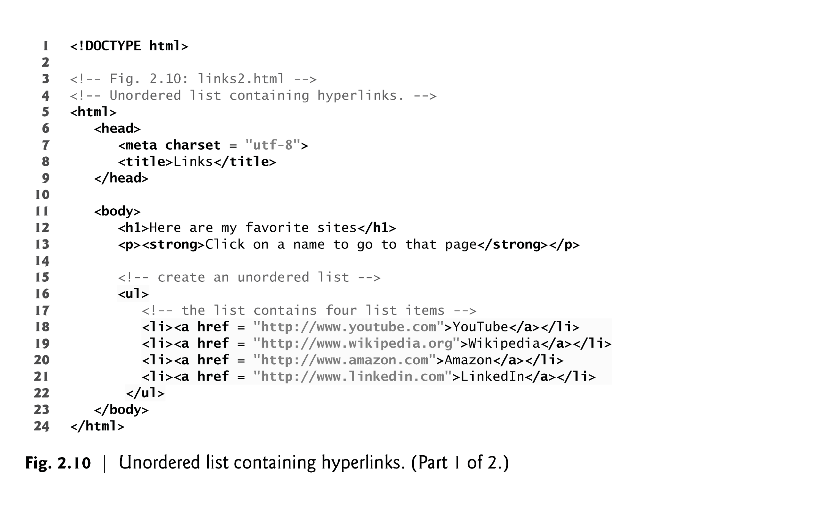
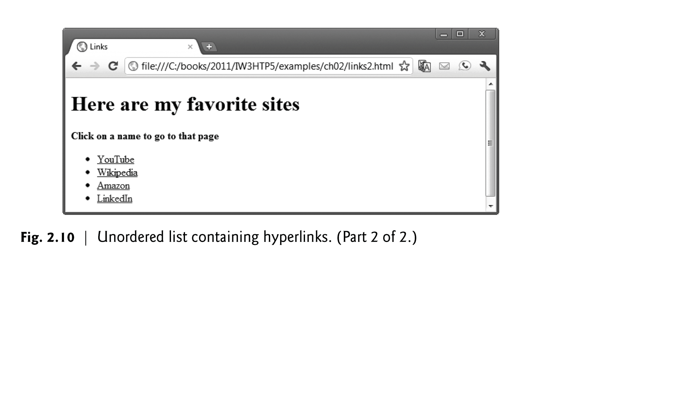
Lists
Unordered list element ul
creates a list in which each item in the list begins with a bullet symbol (typically a disc)
Each entry is an li (list item) element. Most web browsers render these elements with a line break and a bullet symbol at the beginning of the line.

Slide 42
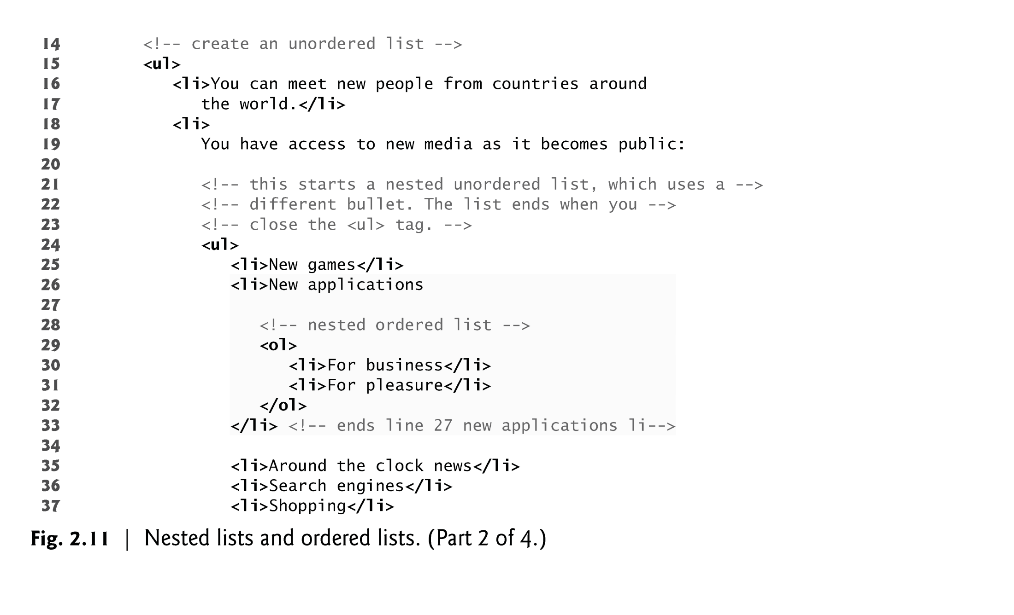
Lists
The ordered-list element ol creates a list in which each item begins with a number.
Lists may be nested to represent hierarchical relationships, as in a multi-level outline.
You should only use an ordered list if the list has an identifiable order!

Slide 43
Special Character
Entity names are case sensitive.
Result | Description | Entity Name | Entity Number
 | non-breaking space | &nbsp; | &#160;
< | less than | &lt; | &#60;
> | greater than | &gt; | &#62;
& | ampersand | &amp; | &#38;
" | double quotation mark | &quot; | &#34;
' | single quotation mark (apostrophe) | &apos; | &#39;
¢ | cent | &cent; | &#162;
£ | pound | &pound; | &#163;
¥ | yen | &yen; | &#165;
€ | euro | &euro; | &#8364;
© | copyright | &copy; | &#169;
® | registered trademark | &reg; | &#174;

Slide 44
meta Elements
Search engines use meta tags to catalog pages:
The name attribute identifies the type of meta element
The content attribute
Of a keywords meta element: provides search engines with a list of words that describe a page, which are compared with words in search requests
Of a description meta element: provides a three- to four-line description of a site in sentence form, used by search engines to catalog your site. This text is sometimes displayed as part of the search result
Meta elements are not visible to users.
Must be placed inside the head section of your HTML documents, otherwise they will not be read by search engines.

Slide 45
Examples
Define keywords for search engines:
<meta name="keywords" content="HTML, CSS, XML, XHTML, JavaScript">
Define a description of your web page:
<meta name="description" content="Free Web tutorials on HTML and CSS">
Define the author of a page:
<meta name="author" content="John Doe">
Setting the viewport to make your website look good on all devices:
<meta name="viewport" content="width=device-width, initial-scale=1.0">

Slide 46
Linking
Your web site should be a collection of several separate pages, they are connected together via hyperlinks.
A hyperlink is created via anchor tag <a> and the document's unique address known as a URL (Uniform Resource Locator).
What are some types of links that you can have on your web page?

Slide 47
Linking
Links can be created to:
external site (or to individual resources such as images or movies on an external site).
other pages or resources within the current site.
other places within the current page.
particular locations on another page.
give instructions to the browser to start the user’s email program.
give instructions to the browser to use the formatting from a css file.
give instruction to the browser to execute a Javascript function.

Slide 48
Linking
A link has three parts:
Destination
The destination is the most important part. It specifies what page will be loaded when user clicks.
Label
The label specifies the text of the hyperlink.
Target
The target is optional. It determines where the destination will be displayed.
The target might be a new window, a different frame, or, most common, the current window.

Slide 49
Links

Slide 50
Link Destinations
Link to an external site.
Link to a resource on an external site.
Link to another page on the same site as this page.
Link to another place on the same page.
Link to specific place on another page.
Link to an email
Link to JavaScript function
Link to a phone number

Slide 51
Link Text
Some guidance … or … don’t “Click Here”
“Click here to see the race results”
“Race Results” or “See Race Results”.
Web browsers typically underline text hyperlinks and color them blue by default.
This is what will be displayed unless you use CSS to override the appearance. In that case you can make the link appear the way you want.
Therefore never underline text and colour it blue if it is not a link!

Slide 52
URL Absolute Referencing
When referencing a page or resource on an external site, a full absolute reference is required:
the protocol (typically, http://),
the domain name,
any paths, and then finally
the file name of the desired resource.
Example:
http://www.microsoft.com/office/word/index.html

Slide 53
URL Absolute Referencing
File-based absolute references should never be used for referencing files within your own site. For example:
C:/My Documents/comp2511/assign2/product.htm
Why?

Slide 54
URL Relative Referencing
We also need to be able to successfully reference files within our site.
This requires learning the syntax for so-called relative referencing.
If all the resources for the site reside within the same directory (also referred to as a folder), then you can reference those other resources simply via their filename.
However, most real-world sites contain too many files to put them all within a single directory, so a relative pathname is required along with the filename.

Slide 55
Relative References
Some Folder
href=“products.html”
index.html
products.html
A reference to another document relative to the location of the document that contains the reference.
Pathnames on the web follow Unix conventions.
Forward slashes (“/”) are used to separate directory names from each other and from file names.
Double-periods (“..”) are used to reference a directory “above” the current one in the directory tree.
Another thing to be aware of is that a reference that begins with the slash is a root reference. A root reference is an absolute references!

Slide 56
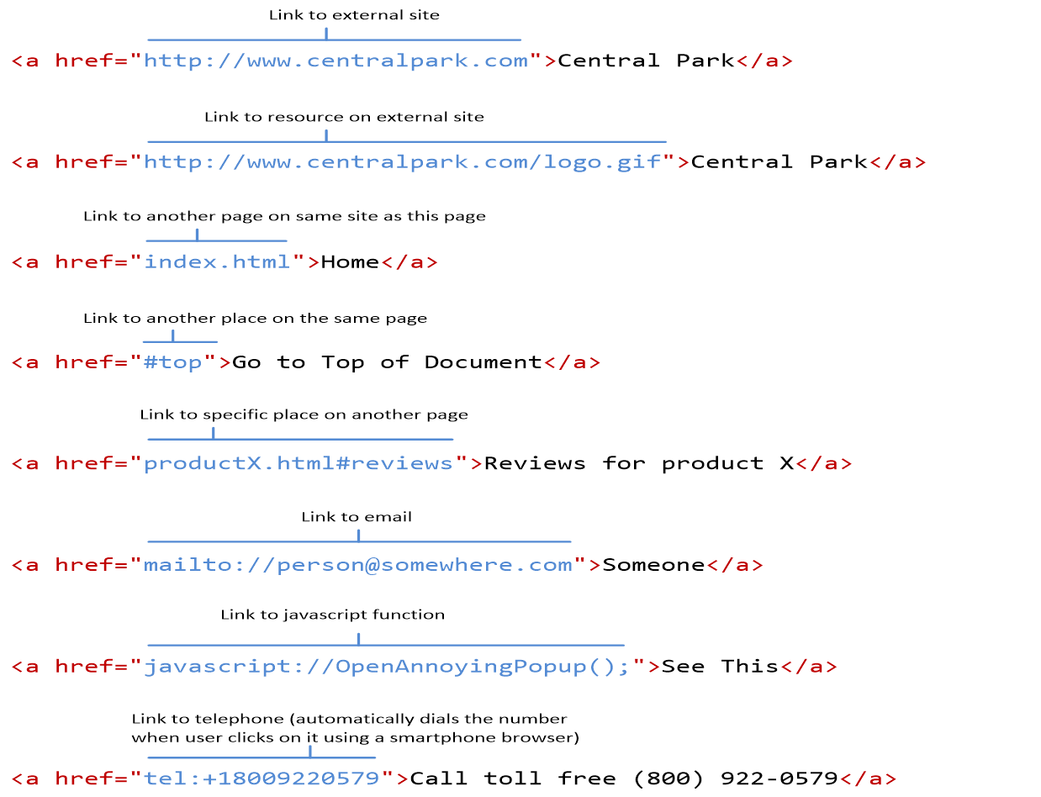

Slide 58
Internal Linking
The a tag can be used to link to another section of the same document by specifying the element’s id as the link’s href.
To link internally to an element with its id attribute set, use the syntax #id.

Slide 59
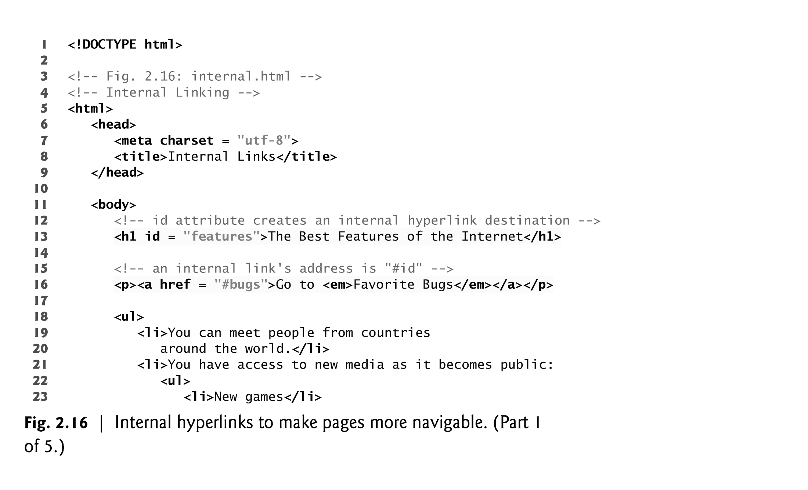
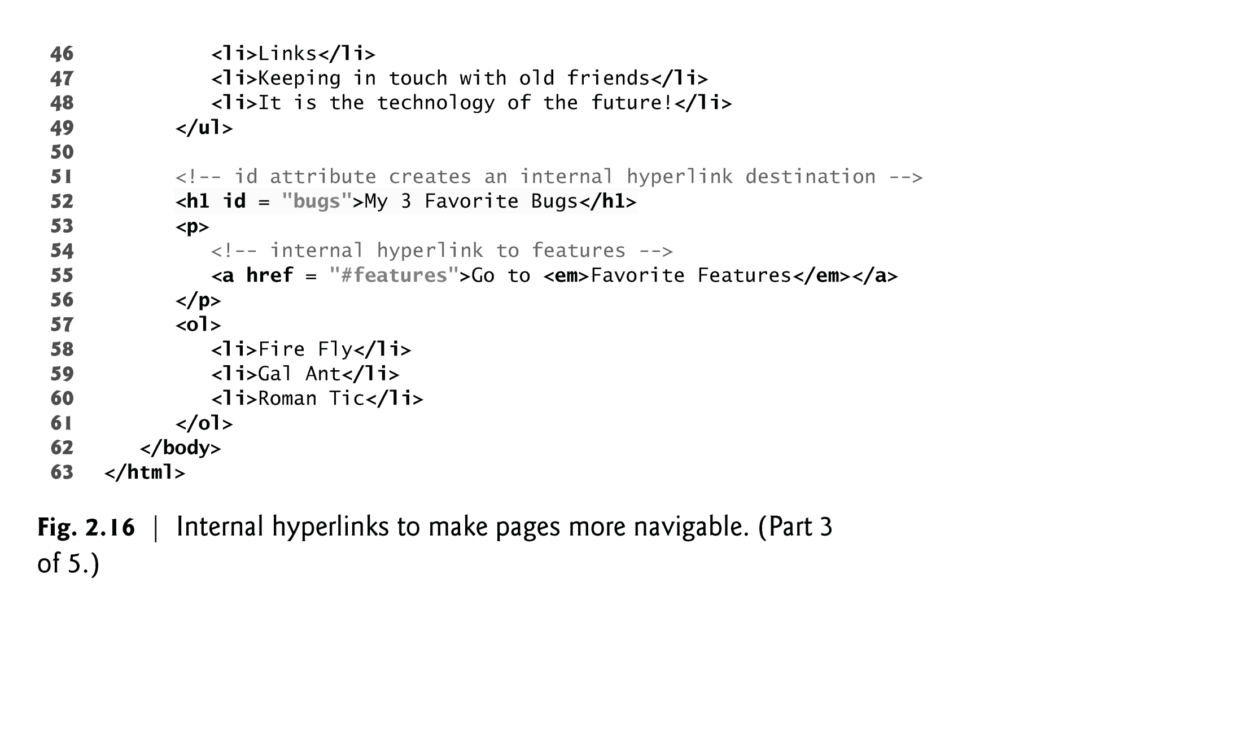
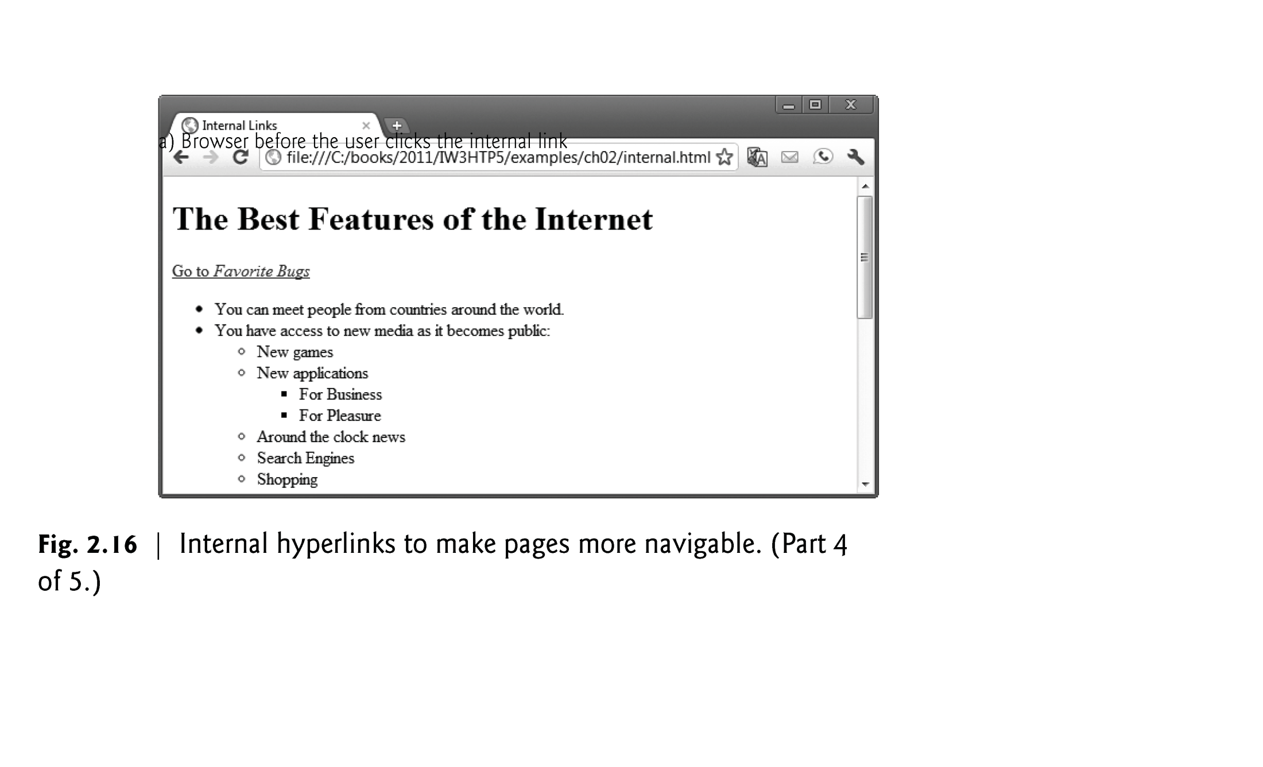
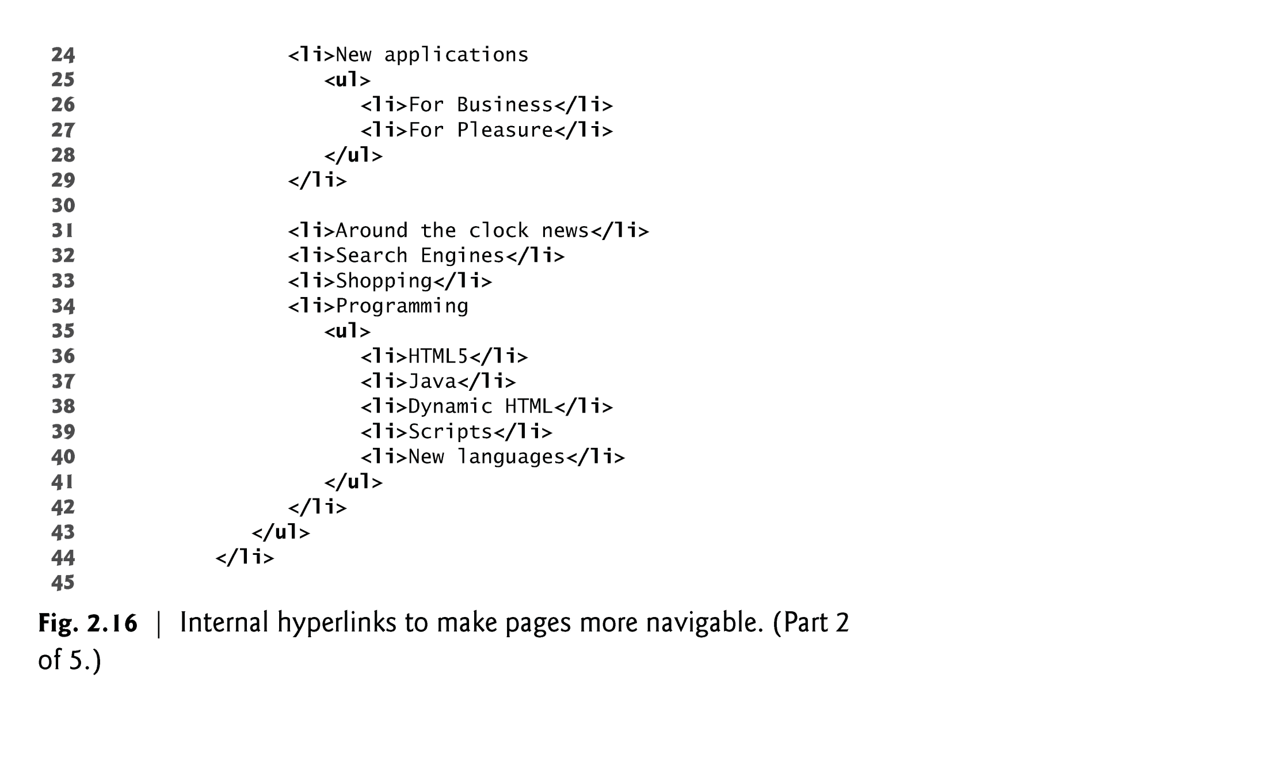
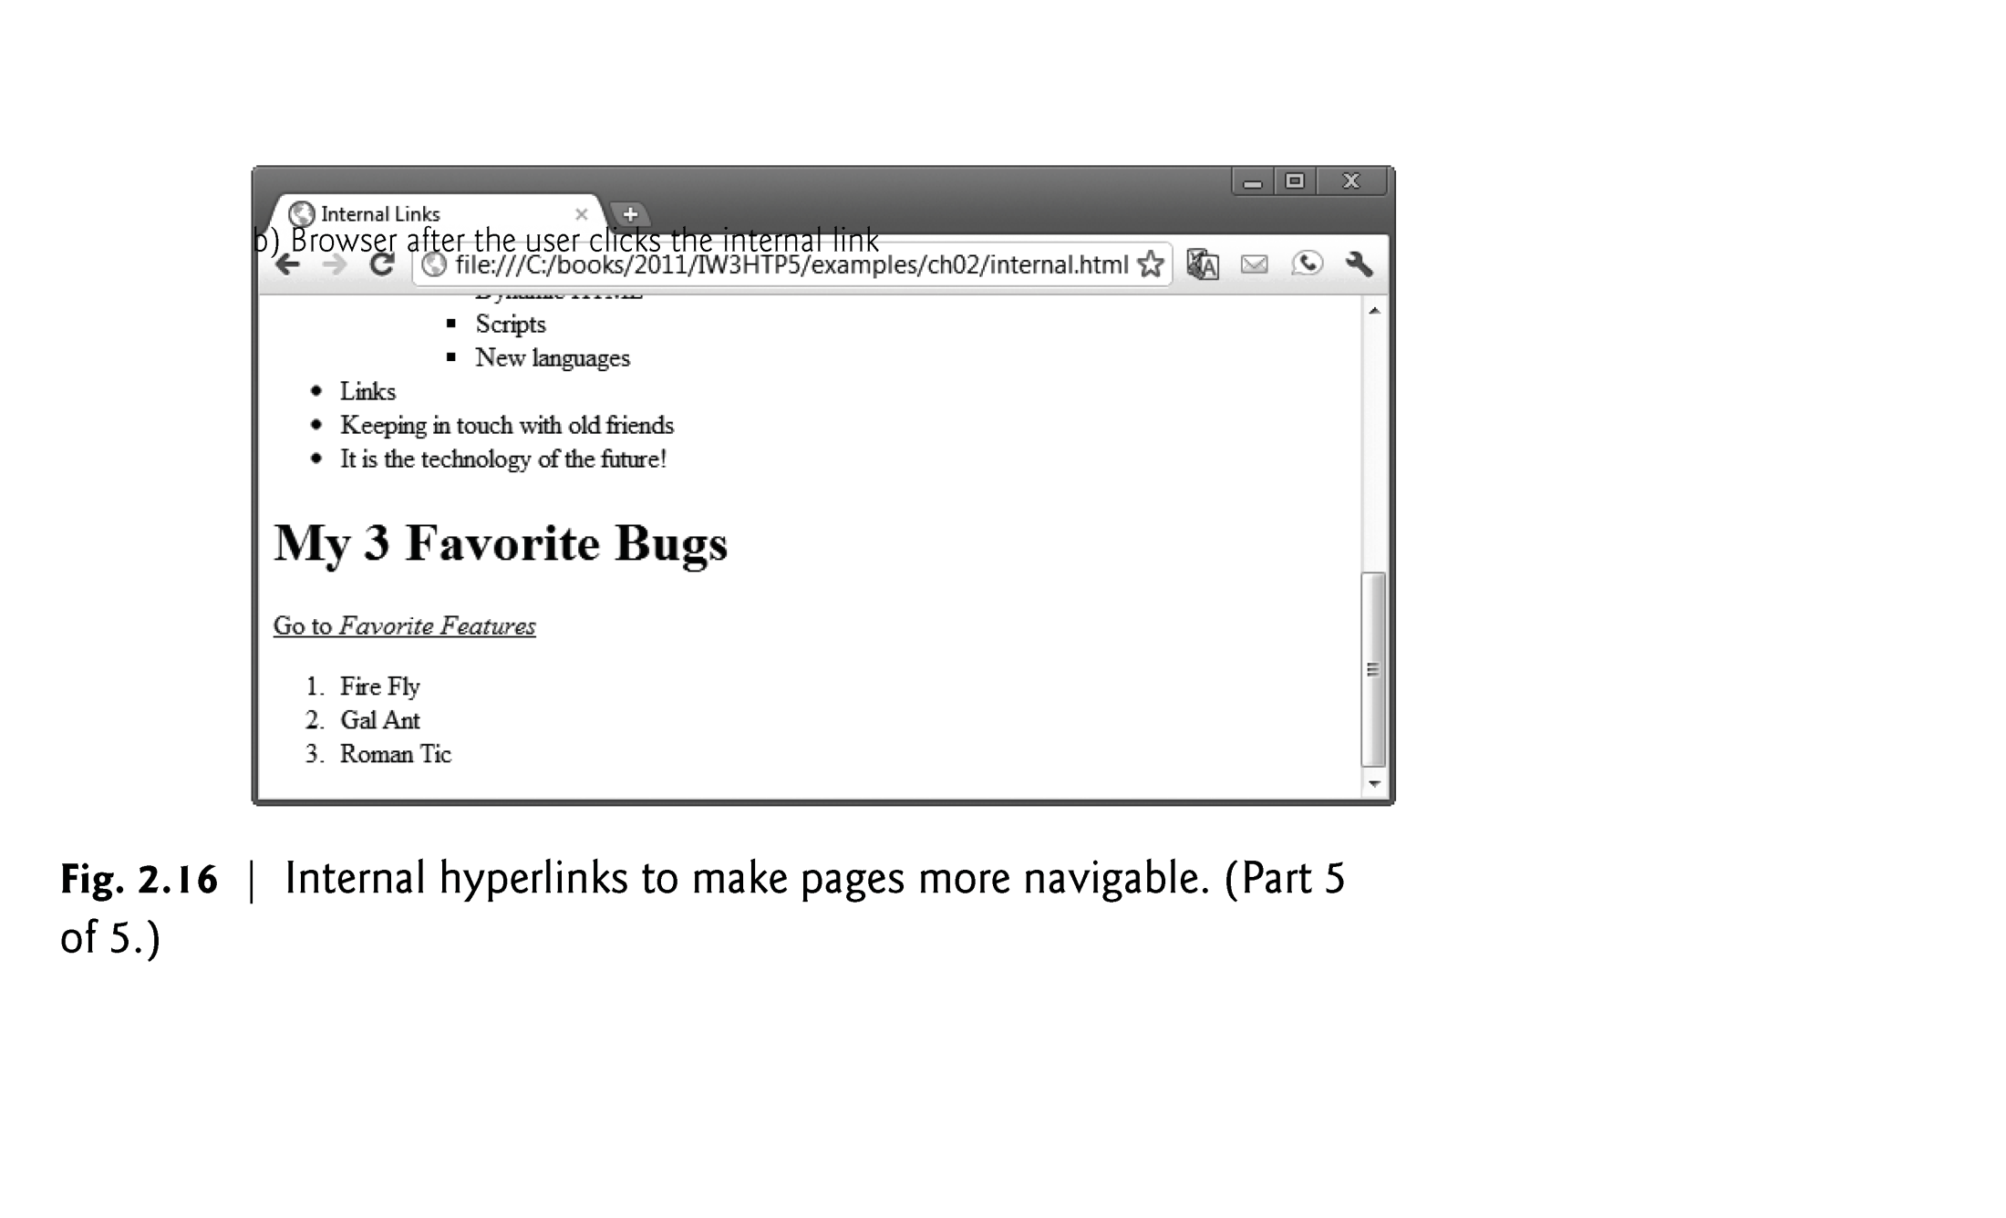

Slide 60
Div & Span
<div> </div>
This <div> tag is a container element and is used to create a logical grouping of your content. It is a block element.
<span> </span>
The span tag is like the div tag. It has no meaning at all and is mostly used for styling by using an id or class. It is an inline element.
A block element, appears on a separate line.
An inline element can be on a line with other elements.

Slide 61
Any Question?

